Slide 1


Around The World in 80 Days
Programming with Python
Master in Data science for economics, business, finance
Prof.
Alfio Ferrara
Authors:
Raffaella Michaela DeMarco
Pietro Russo

Slide 2

Aim of the project
Like a new Phileas Fogg you have the desire to travel around the world always moving east, could you do it in 80 days?
The aim of the project is to help you and show you the best way to fulfill your dream, with the method travel of the AroundTheWorld class .
The starting point is the city of London (GB), but it could be the one you want.

Slide 3
Parameters of AroundTheWorld
dataframe : Dataset of all cities
city_start : Name of the starting city
country_start : Name of the starting country
n_min : Number of the closest cities to which it is possible to travel
x_size : Size of the longitudinal side of the grid used to search for the nearest cities
y_size : Size of the latitudinal side of the grid used to search for the nearest cities
rise_factor : Multiplication factor to increase the grid used to search for the nearest cities

Slide 4
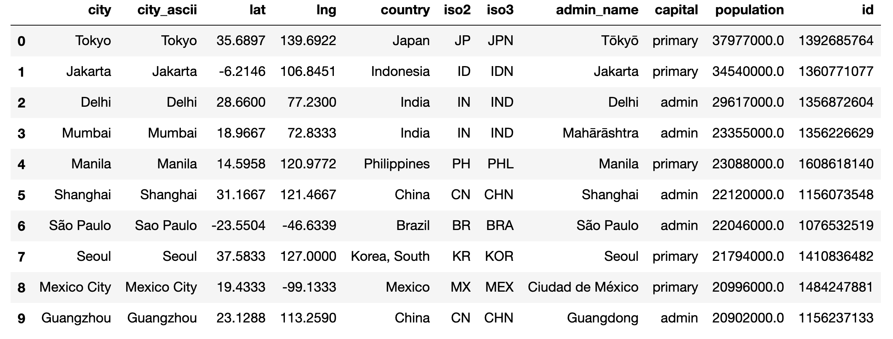
Input Data A dataset with 26569 cities of the world

Slide 5
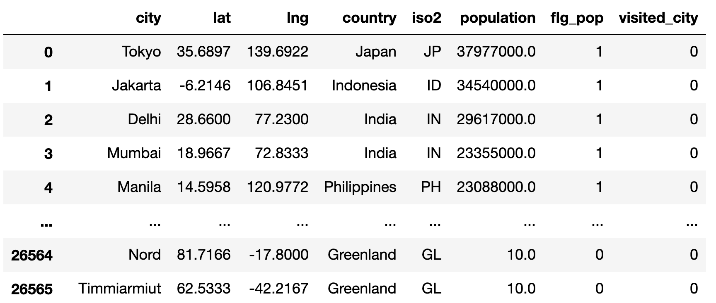
DataFrame definition

Slide 6
Grid definition Move always towards the east
At each step, starting from the city in which it is located, the algorithm calculates a rectangle:
base: the distance between the longitude of the current city and a subsequent point at a variable distance given as input (x_size).
height: changes depending on whether the current city is north (latitude is greater) or south (latitude is lower) of the starting city:
North: height is the distance generated between the latitude of the current city, adding a quantity (y_size/2) and the latitude of the starting city, subtracting a quantity (y_size/2)
South: height is the distance generated between the latitude of the starting city, adding a quantity (y_size/2) and the latitude of the current city, subtracting a quantity (y_size/2)

Slide 7
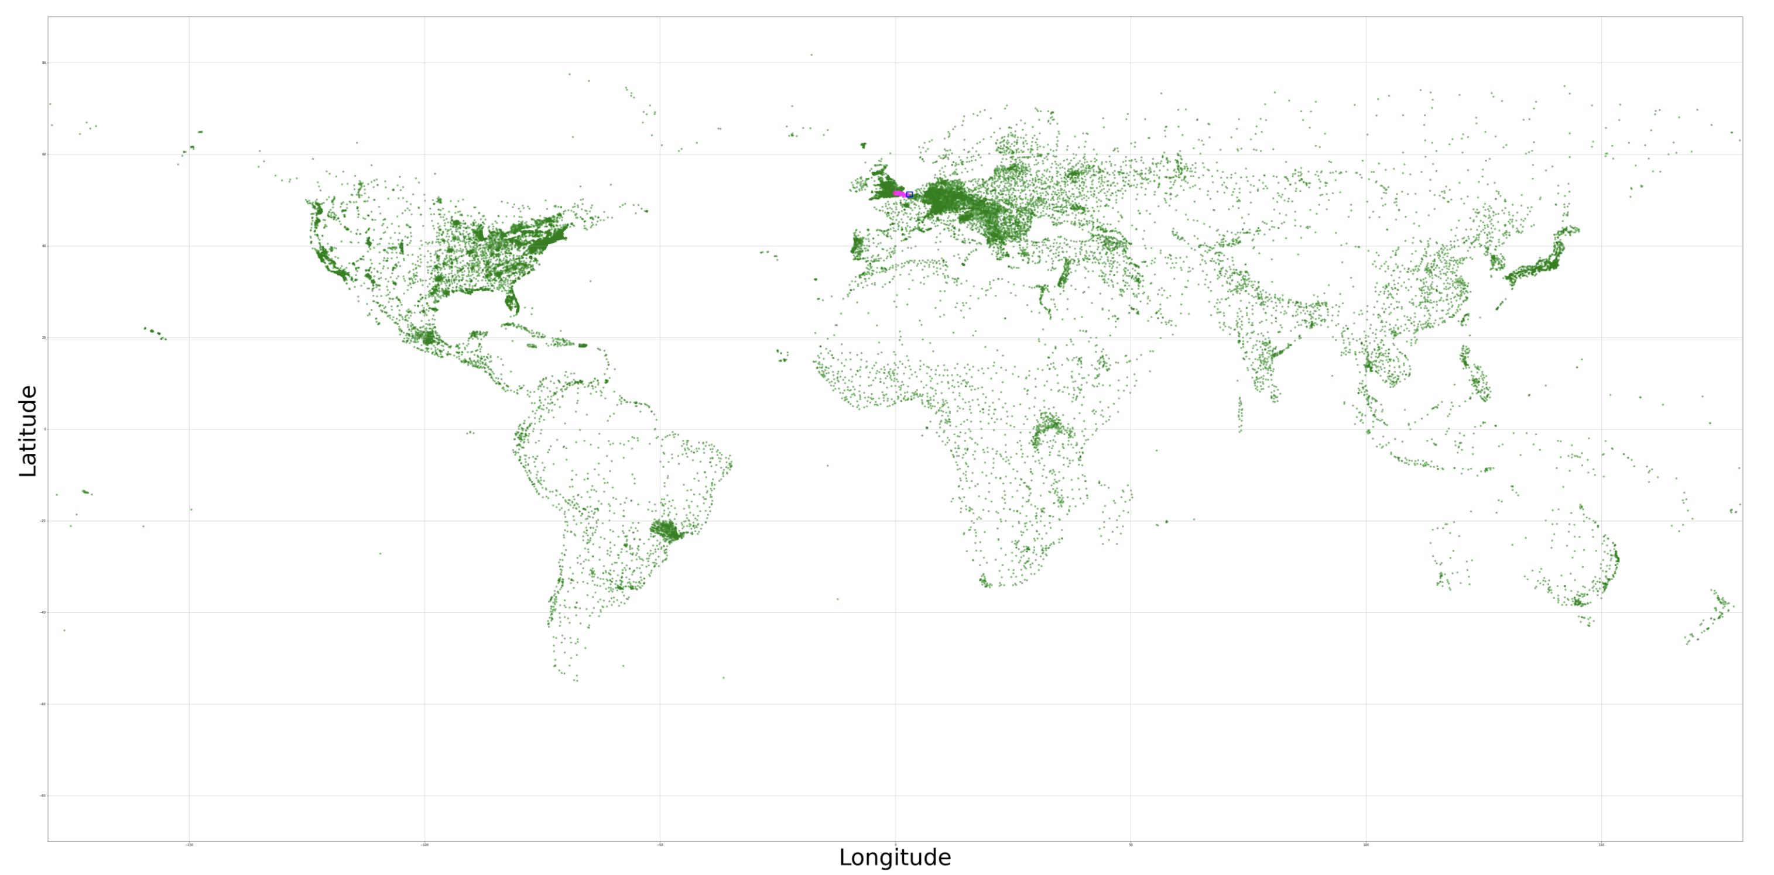

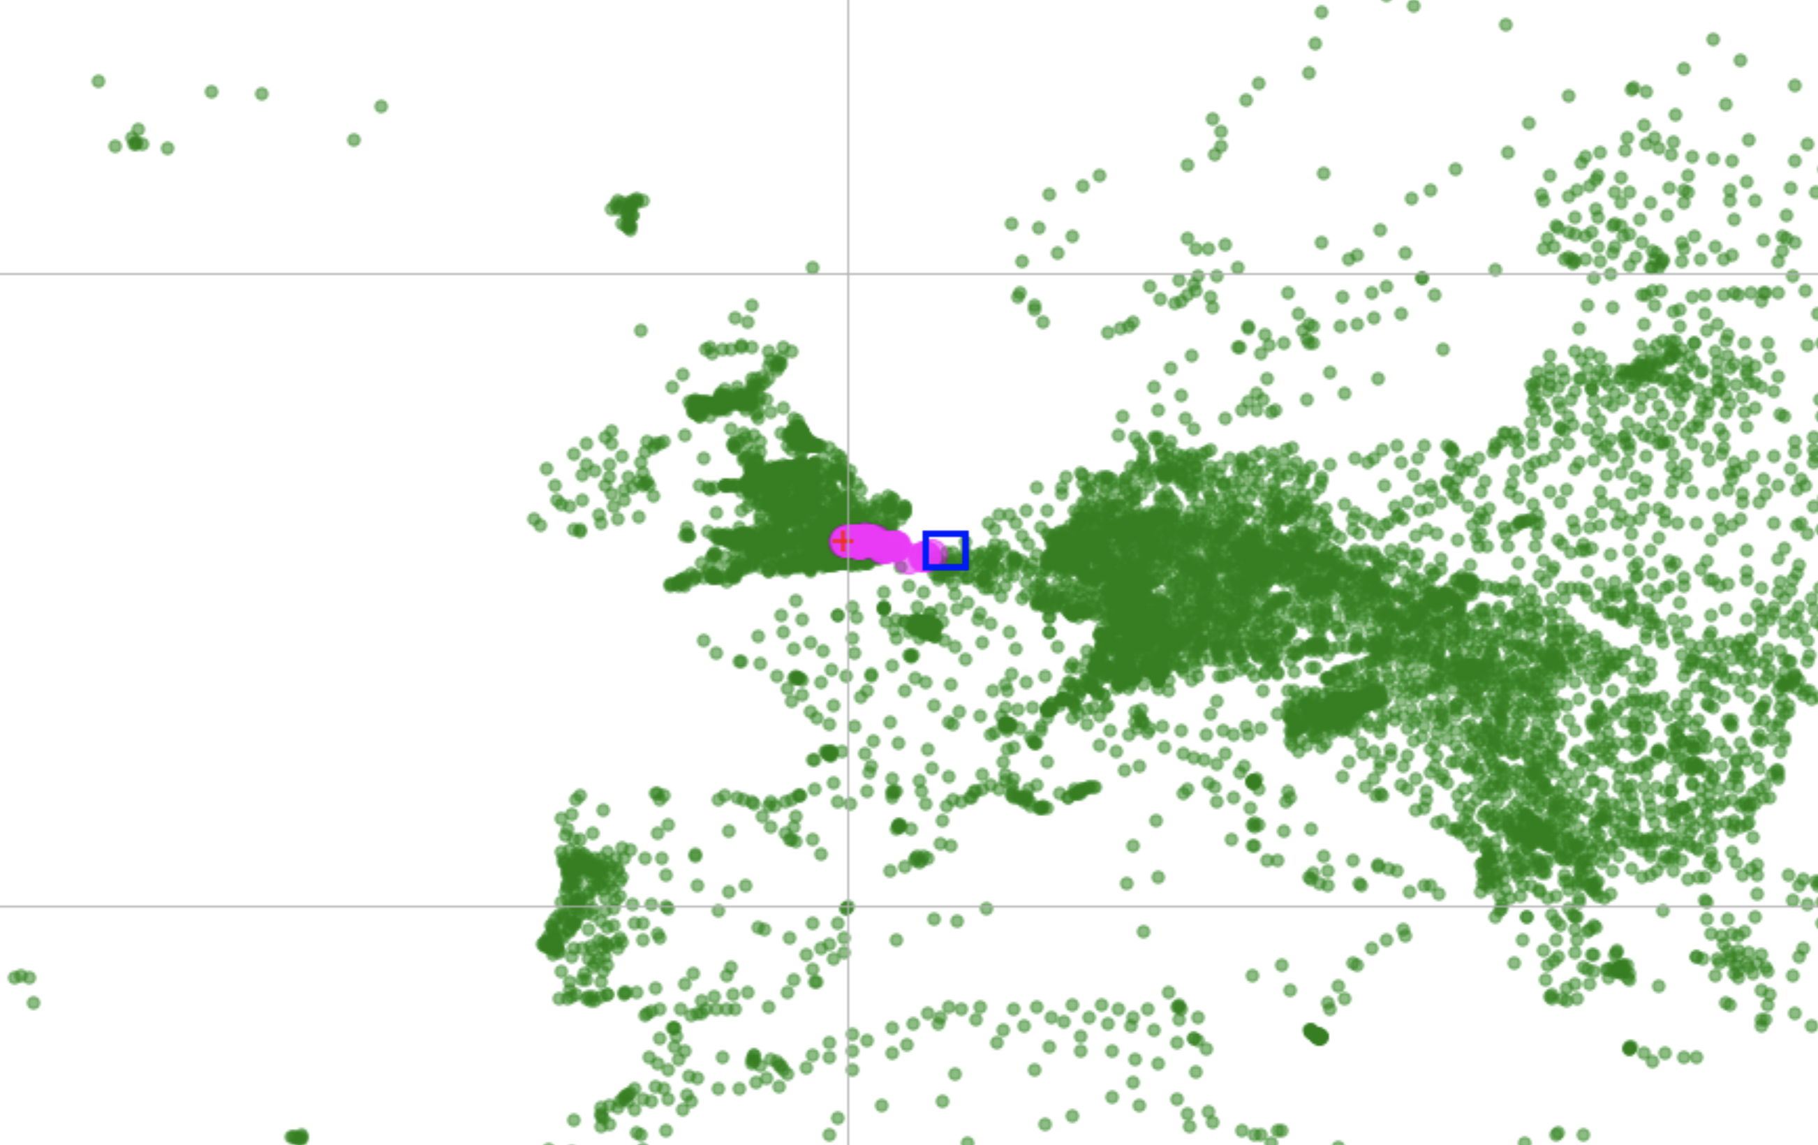
Grid visualization

Slide 8
Weight assignment criteria
Distance: at each step, according to the increasing Euclidean distance, the 3 closest cities are assigned values 2, 4, 8 respectively.
Population: a weight of value 2 is added if the city has a population greater than or equal to 200 thousand inhabitants.
Country: a weight of value 2 is added if the city in the next step is located in a different country than the previous one.

Slide 9
Grid variability What happens when Phileas have to cross oceans?
The size of the polygon considered at each step is variable to ensure the functionality of the algorithm with a minimum number of at least 3 cities.
The absence in the rectangle of at least 3 cities makes these dimensions vary by a multiplicative rise_factor.

Slide 10
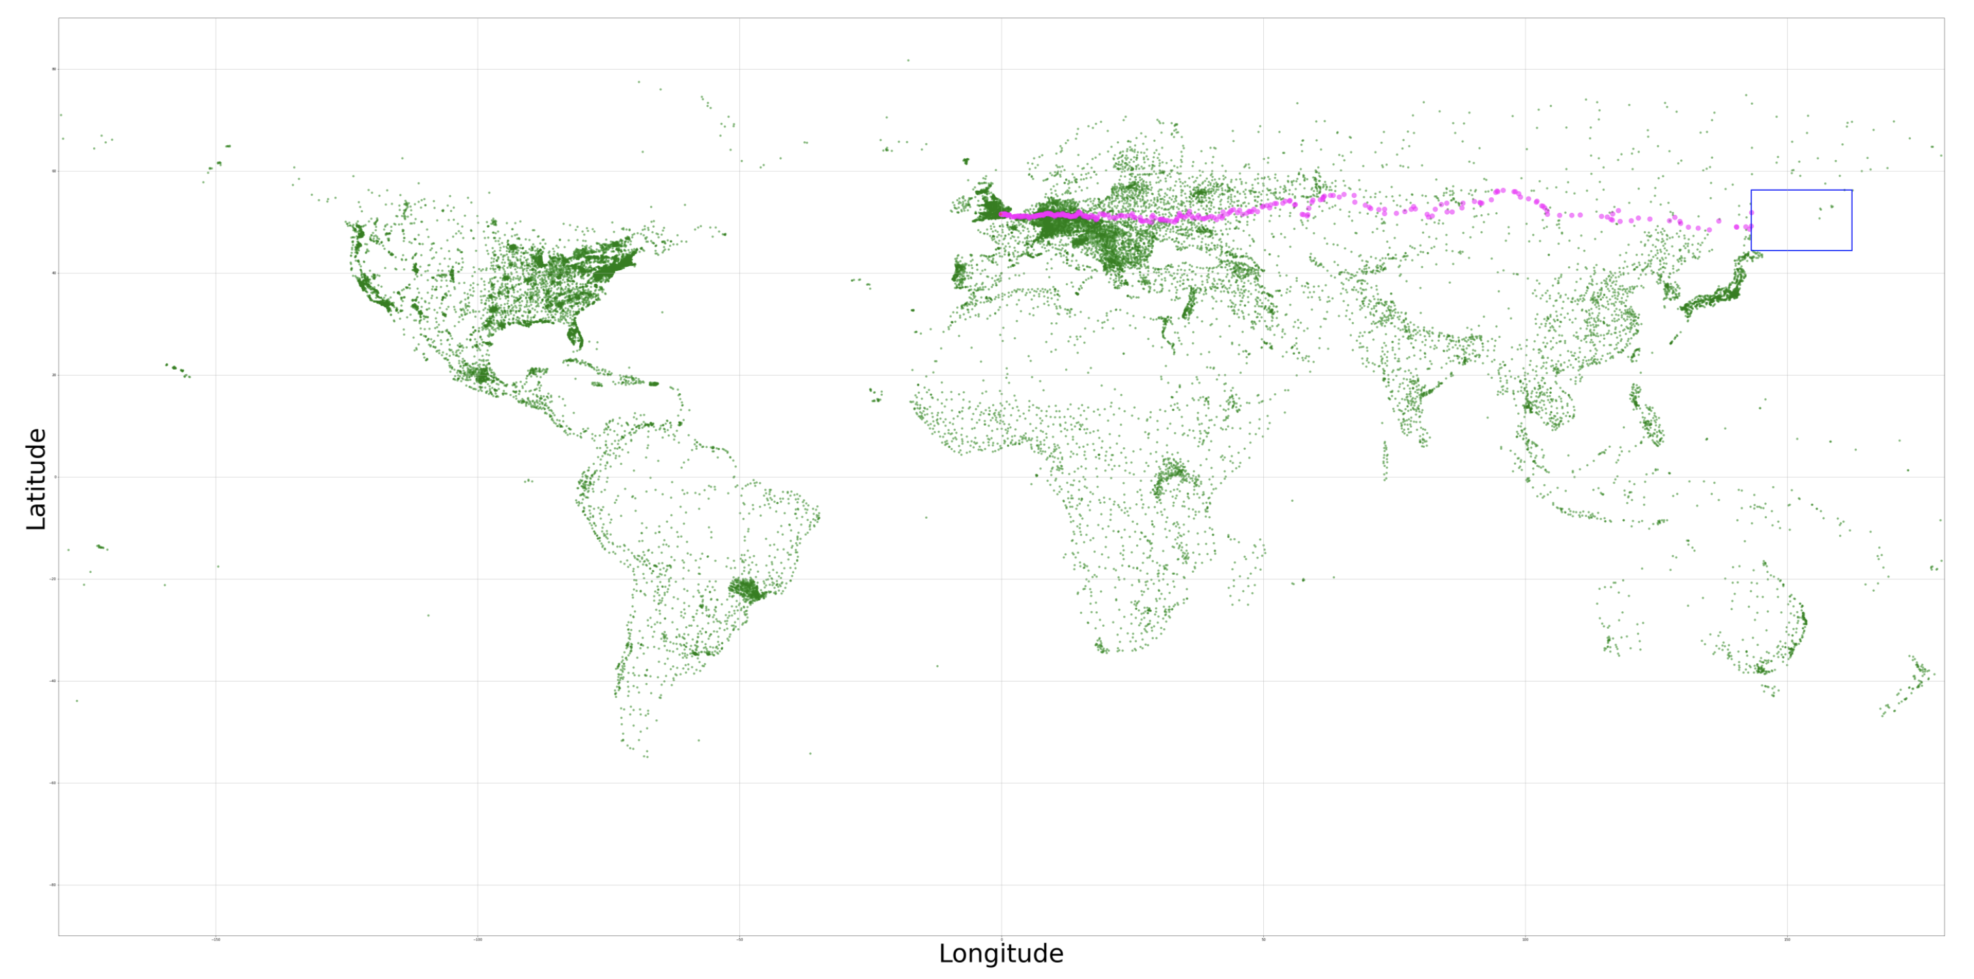
Grid variability visualization

Slide 11
Stop criteria
If among the 3 nearest cities the starting city is present, the algorithm chooses that one, adding up the weight it has.
Once Phileas returns to London, the algorithm returns :
the number of hours taken to complete the journey (sum of the weights of all the steps)
the total number of steps
the dataframe of all the cities visited

Slide 12
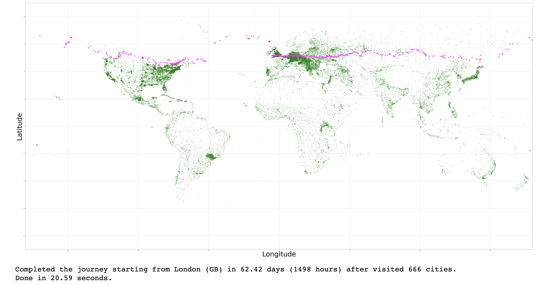
Path

Slide 13
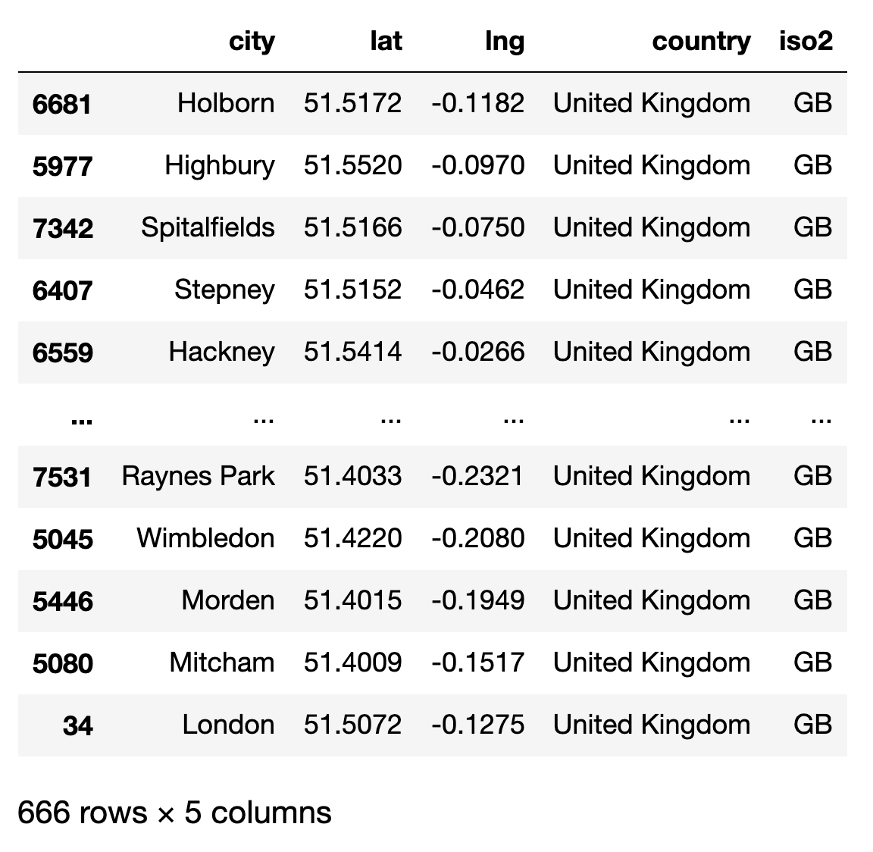
Visited City DataFrame

Slide 14

Thanks for your attention

